Slide 2
Food Safety Management Systems
Food safety management system:
Group of practices and procedures intended to prevent foodborne illness
Actively controls risks and hazards throughout the flow of food
8-2

Slide 3
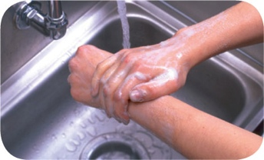
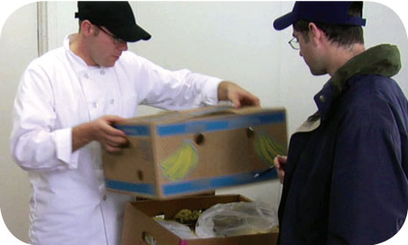
Food Safety Programs
These are the foundation of a food safety management system:
Personal hygiene program
Food safety training program
Supplier selection and specification program
Quality control and assurance program
8-3
Notes:
Instructor Notes
Having food safety programs already in place gives you the foundation for your system. The principles presented in the ServSafe program are the basis of these programs.

Slide 4
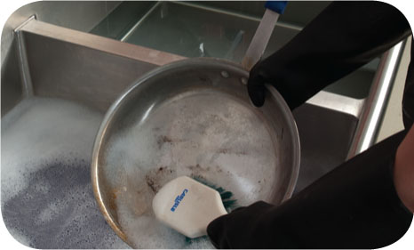
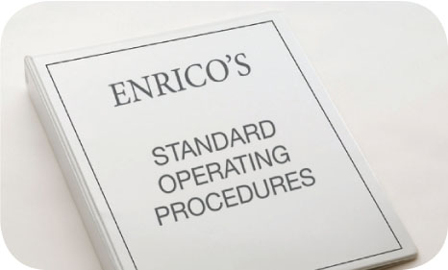
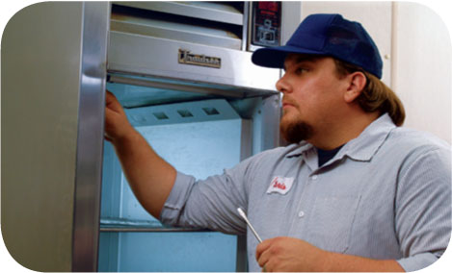
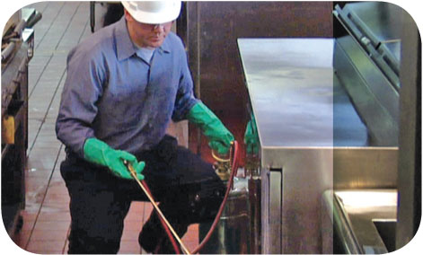
Food Safety Programs
These are the foundation of a food safety management system:
Cleaning and sanitation program
Standard operating procedures (SOPs)
Facility design and equipment maintenance program
Pest control program
8-4
Notes:
Instructor Notes
Having food safety programs already in place gives you the foundation for your system. The principles presented in the ServSafe program are the basis of these programs.

Slide 5
Active Managerial Control
Focuses on controlling the five most common risk factors for foodborne illness:
Purchasing food from unsafe sources
Failing to cook food adequately
Holding food at incorrect temperatures
Using contaminated equipment
Practicing poor personal hygiene
8-5
Notes:
Instructor Notes
It is the manager’s responsibility to actively control these and other risk factors for foodborne illness. This is called active managerial control. It is important to note that active managerial control is proactive rather than reactive. You must anticipate these risks and plan for them.

Slide 6
Active Managerial Control
There are many ways to achieve active managerial control in the operation:
Training programs
Manager supervision
Incorporation of standard operating procedures (SOPs)
HACCP
These are critical to the success of active managerial control:
Monitoring critical activities in the operation
Taking the necessary corrective action when required
Verifying that the actions taken control the risks factors
8-6
Notes:
Instructor Notes
There are many ways to achieve active managerial control in the operation. According to the Food and Drug Administration (FDA), you can use simple tools such as training programs, manager supervision, and the incorporation of SOPs. Active Managerial Control can also be achieved through more complex solutions such as a HACCP Program.
Monitoring is critical to the success of active managerial control. Food will be safe if managers monitor critical activities in the operation.
Managers must also take the necessary corrective action when required. They must also verify that the actions taken to control the risk factors for foodborne illness are actually working.

Slide 7
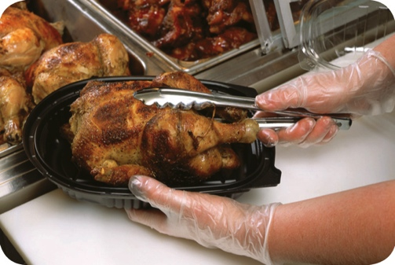
Active Managerial Control
The FDA provides recommendations for controlling the common risk factors for foodborne illness:
Demonstration of knowledge
Staff health controls
Controlling hands as a vehicle of contamination
Time and temperature parameters for controlling pathogens
Consumer advisories
8-7
Notes:
Instructor Notes
Demonstration of knowledge: As a manager, you must be able to show that you know what to do to keep food safe. Becoming certified in food safety is one way to show this.
Staff health controls: Procedures must be put in place to make sure staff are practicing personal hygiene. For example, staff must know that they must report illnesses and illness symptoms to management.
Controlling hands as a vehicle of contamination: Controls must be put in place to prevent bare-hand contact with ready-to-eat food. This might include requiring the use of tongs to handle ready-to-eat food.
Time and temperature parameters for controlling pathogens: Procedures must be put in place to limit the time food spends in the temperature danger zone. Requiring food handlers to check the temperature of food being hot-held every two hours is an example.
Consumer advisories: Notices must be provided to customers if you serve raw or undercooked menu items. These notices must include a statement about the risks of eating these foods.

Slide 8
HACCP
The HACCP approach:
HACCP is based on identifying significant biological, chemical, or physical hazards at specific points within a product’s flow through an operation
Once identified, hazards can be prevented, eliminated, or reduced to safe levels
8-8
Notes:
Instructor Notes
There are many systems you can implement to achieve active managerial control of foodborne illness risk factors. Hazard Analysis Critical Control Point (HACCP) is one such system. HACCP (pronounced HASS-ip) is based on identifying significant biological, chemical, or physical hazards at specific points within a product’s flow. Once identified, the hazards can be prevented, eliminated, or reduced to safe levels.

Slide 9
HACCP
To be effective, a HACCP system must be based on a written plan:
It must be specific to each facility’s menu, customers, equipment, processes, and operations
A plan that works for one operation may not work for another
8-9
Notes:
Instructor Notes
Each HACCP plan is unique, a plan that works for one operation may not work for another.

Slide 10
The 7 HACCP Principles
The seven HACCP principles:
Conduct a hazard analysis
Determine critical control points (CCPs)
Establish critical limits
Establish monitoring procedures
Identify corrective actions
Verify that the system works
Establish procedures for record keeping and documentation
8-10
Notes:
Instructor Notes
In general terms, the HACCP principles can be broken into three groups:
Principles 1 and 2 help you identify and evaluate your hazards.
Principles 3, 4, and 5 help you establish ways for controlling those hazards.
Principles 6 and 7 help you maintain the HACCP plan and system and verify its effectiveness.

Slide 11
Activity
Time for a HACCP Story
8-11
Notes:
Instructor Notes
You are about to illustrate the seven HACCP principles using an analogy. This analogy helps students understand the HACCP principles by relating HACCP to a traffic accident story. As you present the next seven slides, read the instructor notes on the bottom of each slide to the class. The eighth slide will tie the whole analogy together. This is a proven technique for helping students understand the seven HACCP principles.

Slide 12
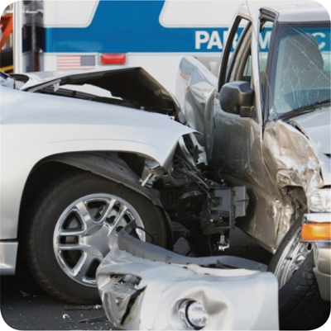
HACCP Principles Analogy
The Situation
8-12
Notes:
Instructor Notes
Read the following scenario to the class:
“A town has been experiencing several car accidents. Multiple people have been killed. Town residents are in an uproar and demand that town officials do something. Town officials vow to look into the problem and reduce the accidents.”

Slide 13
HACCP Principles Analogy
1. Conduct a hazard analysis
8-13
Notes:
Instructor Notes
Read the following scenario to the class:
“Town officials start by analyzing police reports from the accidents to try to figure out the hazard that is causing them.”

Slide 14
HACCP Principles Analogy
2. Determine critical control points
8-14
Notes:
Instructor Notes
Read the following scenario to the class:
“They realize that cars are driving too fast, which is causing accidents. They determine that if they can control the speed of the cars on their roads, accidents will be reduced and lives will be saved.”

Slide 15
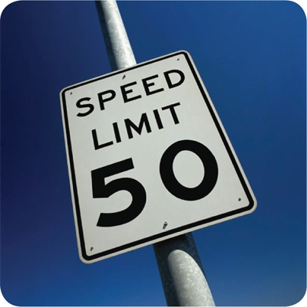
HACCP Principles Analogy
3. Establish critical limits
8-15
Notes:
Instructor Notes
Read the following scenario to the class:
“Town officials impose a speed limit to reduce accidents. The new speed limit is 50 mph.”

Slide 16
HACCP Principles Analogy
4. Establish monitoring procedures
8-16
Notes:
Instructor Notes
Read the following scenario to the class:
“To make sure people don’t drive faster than the new speed limit, police use radar to monitor the speed limit.”

Slide 17
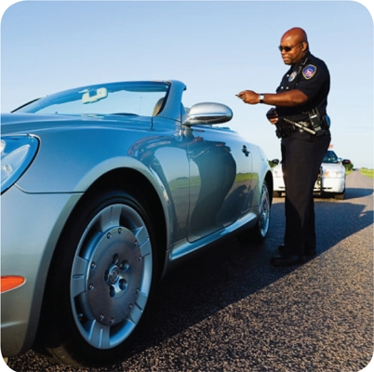
HACCP Principles Analogy
5. Identify corrective actions
8-17
Notes:
Instructor Notes
Read the following scenario to the class:
“When people are caught driving above the speed limit, they are given a speeding ticket by the police. Because they don’t want to get another ticket, people slow down when driving through town.”

Slide 18
HACCP Principles Analogy
6. Verify the system works
8-18
Notes:
Instructor Notes
Read the following scenario to the class:
“Town officials want to see if the new speed limit is reducing accidents in town. They review accident reports and see a decline in the number of accidents, proving that speeding is the cause of the previous accidents. This verifies that imposing a speed limit was the right thing to do.”

Slide 19
HACCP Principles Analogy
7. Establish record keeping and documentation procedures
8-19
Notes:
Instructor Notes
Read the following scenario to the class:
“Town officials want to stay on top of the situation, so they require the police department to keep accident records and speeding tickets on file for the next five years.”

Slide 20
HACCP: The 7 HACCP Principles Analogy
The Seven HACCP Principles
What hazard were town officials trying to control?
What did they decide was critical to control the hazard?
What limit did they establish to slow cars down?
How did the town monitor the new speed limit?
What action was taken by drivers who received tickets?
How did town officials verify that the new speed limit was reducing accidents?
What did town officials do to stay on top of the situation?
8-20
Notes:
Instructor Notes
Answers:
Accidents (conduct a hazard analysis)
Lowering the speed limit (determine critical control points)
A speed limit of 50 mph (establish critical limits)
Police monitored the speed of cars using radar (establish monitoring procedures)
Drivers were given tickets when caught speeding (identify corrective actions)
Reviewed accident reports (verify the system works)
Required police to keep accident records and speeding tickets on file for five years (establish record keeping and documentation procedures)

Slide 21
The 7 HACCP Principles
Principle 1: Conduct a hazard analysis
Identify potential hazards in the food served by looking at how it is processed
Identify TCS food items and determine where hazards are likely to occur for each one; look for biological, chemical, and physical contaminants
8-21

Slide 22
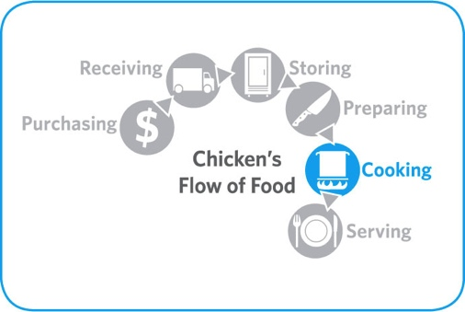
The 7 HACCP Principles
Principle 2: Determine critical control points (CCPs)
Find points in the process where identified hazards can be prevented, eliminated, or reduced to safe levels—these are the CCPs
Depending on the process, there may be more than one CCP
8-22

Slide 23
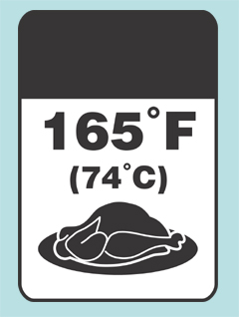
The 7 HACCP Principles
Principle 3: Establish critical limits
For each CCP, establish minimum or maximum limits
These limits must be met to
Prevent or eliminate the hazard
Reduce it to a safe level
Critical
Limit
8-23

Slide 24
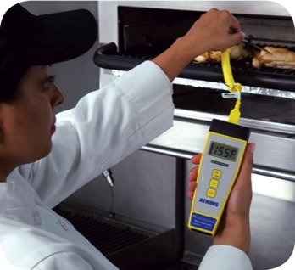
The 7 HACCP Principles
Principle 4: Establish monitoring procedures
Determine the best way to check critical limits
Make sure they are consistently met
Identify who will monitor them and how often
8-24

Slide 25
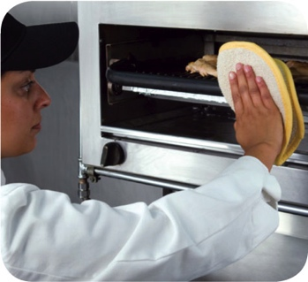
The 7 HACCP Principles
Principle 5: Identify corrective actions
Identify steps that must be taken when a critical limit is not met
Determine these steps in advance
8-25

Slide 26
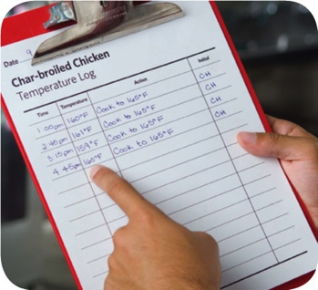
The 7 HACCP Principles
Principle 6: Verify that the system works
Determine if the plan is working as intended
Evaluate the plan on a regular basis using
Monitoring charts
Records
Hazard analysis
Determine if your plan prevents, reduces, or eliminates identified hazards
8-26

Slide 27
The 7 HACCP Principles
Principle 7: Establish procedures for record keeping and documentation
Keep records for these actions:
Monitoring activities
Corrective actions
Validating equipment (checking for good working condition)
Working with suppliers (invoices, specifications, etc.)
8-27

Slide 28
HACCP
These specialized processing methods require a variance and may require a HACCP plan:
Smoking food as a method to preserve it (but not to enhance flavor)
Using food additives or components, such as vinegar, to preserve or alter food so it no longer requires time and temperature control for safety
Curing food
Custom-processing animals
8-28
Notes:
Instructor Notes
Some food processes are highly specialized and can be a serious health risk if specific procedures are not followed. Typically these processes are carried out at processing plants.
A variance from the regulatory authority will be required before processing food this way. A variance is a document that allows a requirement to be waived or changed.
A HACCP plan may also be required if the processing method carries a higher risk of causing a foodborne illness. There may also be dangers unique to these processes that are best addressed by HACCP.

Slide 29
HACCP
These specialized processing methods require a variance and may require a HACCP plan:
Packaging food using ROP methods including
MAP
Vacuum-packed
Sous vide
Treating (e.g. pasteurizing) juice on-site and packaging it for later sale
Sprouting seeds or beans
8-29
Notes:
Instructor Notes
Always check with your local regulatory authority to see if a variance is also required when prepping food in these ways.
A HACCP plan is required when packaging food using reduced-oxygen packaging (ROP) methods. This includes MAP, vacuum-packed, and sous vide food. Clostridium botulinum and Listeria monocytogenes are risks to food packaged in these ways.

Slide 30
Review
Let’s Review
8-30
Notes:
Instructor Notes
Review the content presented using the next several PowerPoint slides.
To ensure that everyone in class participates, pass out index cards with the letters A, B, C, D, E, F, and G on them. Have each student answer each question by holding up the correct letter.

Slide 31
Review
Checking to see if critical limits are met
A. Hazard analysis
B. Critical control points
C. Critical limits
D. Monitoring
E. Corrective action
F. Verification
G. Record keeping and documentation
8-31
Notes:
Instructor Notes
The answer is D. Once critical limits have been created, determine the best way for your operation to check them. Make sure the limits are consistently met. Identify who will monitor them and how often.

Slide 32
Review
Keeping HACCP plan documents
A. Hazard analysis
B. Critical control points
C. Critical limits
D. Monitoring
E. Corrective action
F. Verification
G. Record keeping and documentation
8-32
Notes:
Instructor Notes
The answer is G. Maintain your HACCP plan and keep all documentation created when developing it. Keep records for the following actions:
• Monitoring activities
• Taking corrective action
• Validating equipment (checking for good working condition)
• Working with suppliers (i.e., shelf-life studies, invoices, specifications, challenge studies, etc.)

Slide 33
Review
Assessing risks within the flow of food
A. Hazard analysis
B. Critical control points
C. Critical limits
D. Monitoring
E. Corrective action
F. Verification
G. Record keeping and documentation
8-33
Notes:
Instructor Notes
The answer is A. First, identify and assess potential hazards in the food you serve. Start by looking at how food is processed in your operation. Many types of food are processed in similar ways.

Slide 34
Review
Specific places within the flow of food where hazards can be prevented, eliminated, or reduced to a safe level
A. Hazard analysis
B. Critical control points
C. Critical limits
D. Monitoring
E. Corrective action
F. Verification
G. Record keeping and documentation
8-34
Notes:
Instructor Notes
The answer is B. Find the points in the process where the identified hazard(s) can be prevented, eliminated, or reduced to safe levels. These are the critical control points (CCPs). Depending on the process, there may be more than one CCP.

Slide 35
Review
Predetermined step taken when a critical limit is not met
A. Hazard analysis
B. Critical control points
C. Critical limits
D. Monitoring
E. Corrective action
F. Verification
G. Record keeping and documentation
8-35
Notes:
Instructor Notes
The answer is E. Identify steps that must be taken when a critical limit is not met. These steps should be determined in advance.

Slide 36
Review
Minimum or maximum boundaries that must be met to prevent a hazard
A. Hazard analysis
B. Critical control points
C. Critical limits
D. Monitoring
E. Corrective action
F. Verification
G. Record keeping and documentation
8-36
Notes:
Instructor Notes
The answer is C. For each CCP, establish minimum or maximum limits. These limits must be met to prevent or eliminate the hazard, or to reduce it to a safe level.

Slide 37
Review
Determining if the HACCP plan is working as intended
A. Hazard analysis
B. Critical control points
C. Critical limits
D. Monitoring
E. Corrective action
F. Verification
G. Record keeping and documentation
8-37
Notes:
Instructor Notes
The answer is F. Determine if the plan is working as intended. Evaluate it on a regular basis. Use your monitoring charts, records, hazard analysis, etc.; and determine if your plan prevents, reduces, or eliminates identified hazards.

